Slide 1
Title –Prediction of Company Sales.
By
Pranit Pisal

Slide 2

Objective
The objective is to know about the segments or attributes that causes high sales.

Slide 3

Solution
Doing EDA on current dataset.
Using Decision Tree Regressor over the current data.
Analysing the insights and Graph patterns.
Finding out the right patterns.
Checking the values on which the company sales depends upon.
Choosing the efficient AI model.

Slide 4
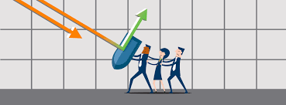

Business Impact
The solution provides help in increase in the sales in Urban as well as rural areas according to the situation.

